Slide 1
Instrumental Variables for Causal Effect Estimation
by ZongyuLi

Slide 2
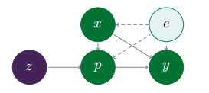
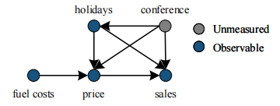




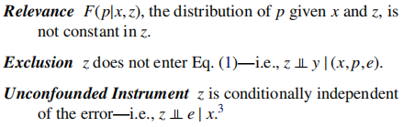

Deep IV
Hartford J, Lewis G, Leyton-Brown K, et al. Deep IV: A flexible approach for counterfactual prediction[C]//International Conference on Machine Learning. PMLR, 2017: 1414-1423.

Slide 3


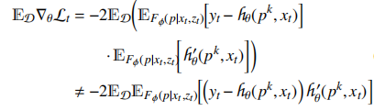
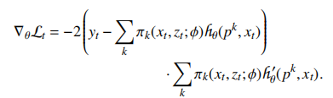

Deep IV
Optimization for DeepIV networks
First stage: Treatment network
Second stage: Outcome network
Hartford J, Lewis G, Leyton-Brown K, et al. Deep IV: A flexible approach for counterfactual prediction[C]//International Conference on Machine Learning. PMLR, 2017: 1414-1423.

Slide 4
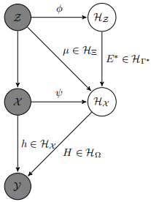
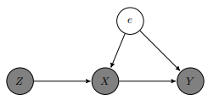
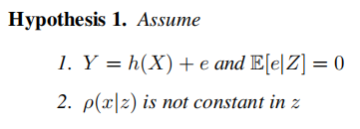
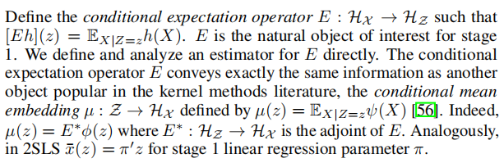
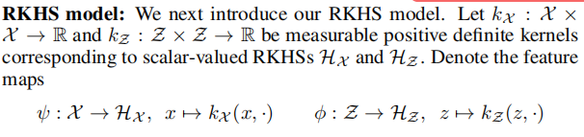
Kernel IV
Singh R, Sahani M, Gretton A. Kernel instrumental variable regression[J]. Advances in Neural Information Processing Systems, 2019, 32.

Slide 5
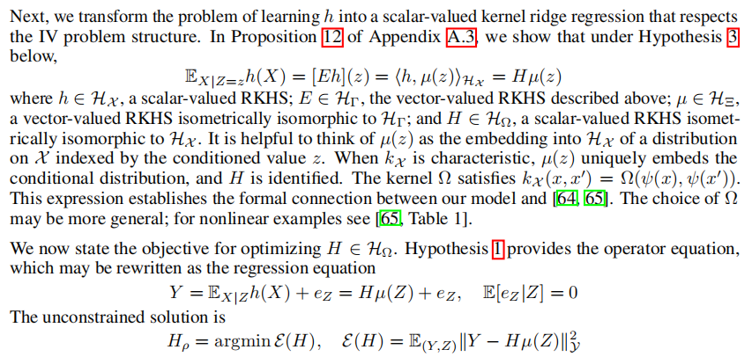
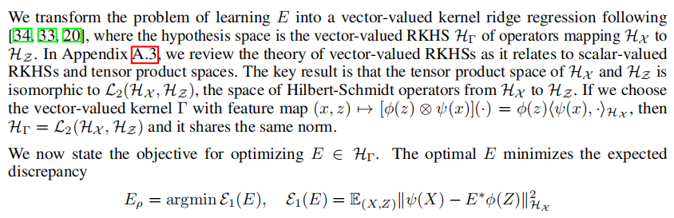
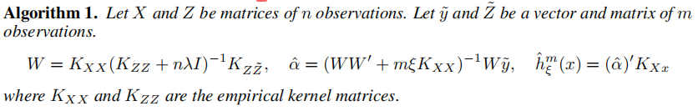
Kernel IV
Stage Two
Stage One
m：n最佳比率
Singh R, Sahani M, Gretton A. Kernel instrumental variable regression[J]. Advances in Neural Information Processing Systems, 2019, 32.

Slide 6
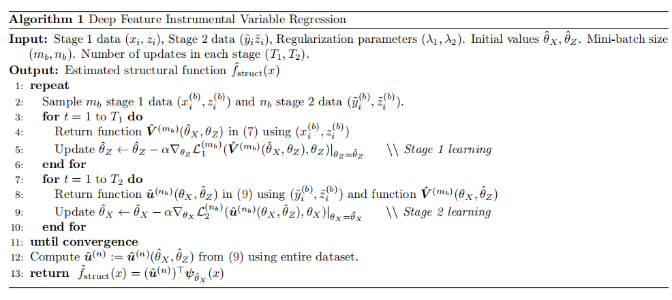
DFIV≈Deep IV+Kernel IV
Xu L, Chen Y, Srinivasan S, et al. Learning deep features in instrumental variable regression[J]. arXiv preprint arXiv:2010.07154, 2020.

Slide 7
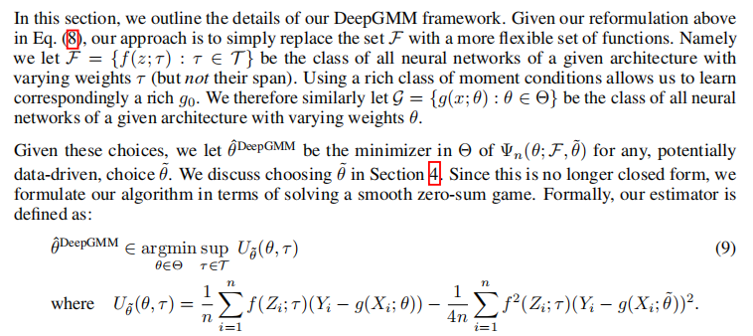
DeepGMM≈Deep IV+GMM
Bennett A, Kallus N, Schnabel T. Deep generalized method of moments for instrumental variable analysis[J]. Advances in neural information processing systems, 2019, 32.

Slide 8
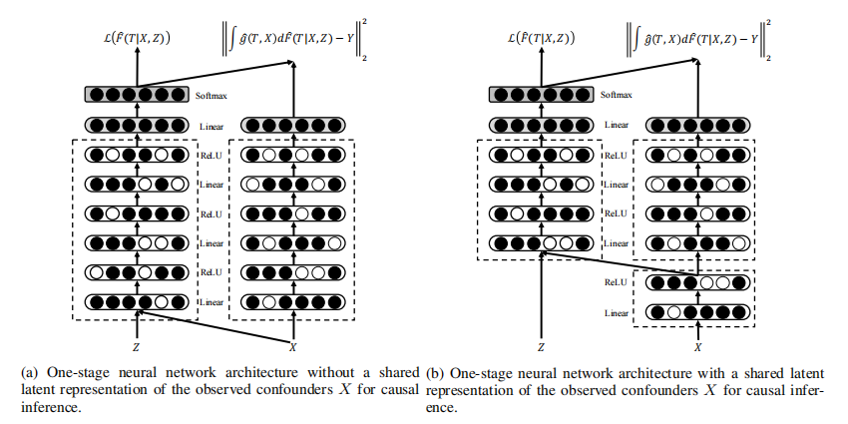


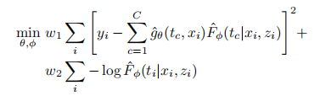
OneSIV≈Deep IV+One-stage
Lin A, Lu J, Xuan J, et al. One-stage deep instrumental variable method for causal inference from observational data[C]//2019 IEEE International Conference on Data Mining (ICDM). IEEE, 2019: 419-428.

Slide 9
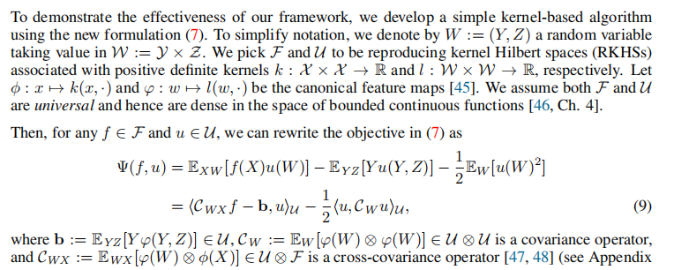
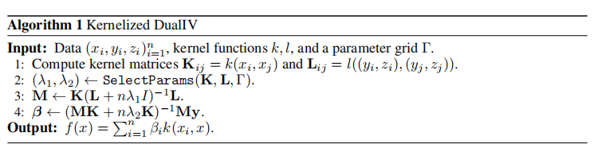
DualIV≈Kernel IV+One-stage
Muandet K, Mehrjou A, Lee S K, et al. Dual instrumental variable regression[J]. Advances in Neural Information Processing Systems, 2020, 33: 2710-2721.

Slide 10
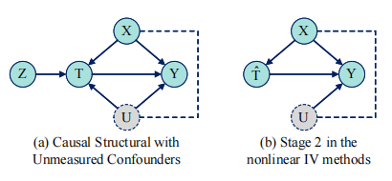







CB-IV
Confounder Balancing
Outcome Regression
Optimization
Treatment Regression
Counterfactual Prediction Function
Wu A, Kuang K, Li B, et al. Instrumental variable regression with confounder balancing[C]//International Conference on Machine Learning. PMLR, 2022: 24056-24075.

Slide 11
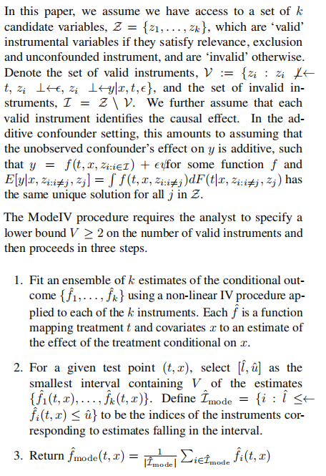
ModelIV
Hartford J S, Veitch V, Sridhar D, et al. Valid causal inference with (some) invalid instruments[C]//International Conference on Machine Learning. PMLR, 2021: 4096-4106.

Slide 12
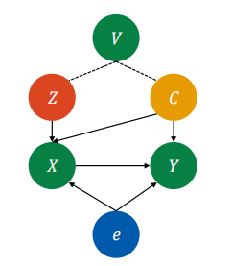




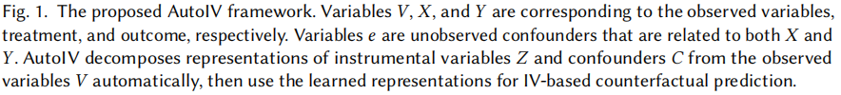

AutoIV
Learning relevance
Learning exclusion
Yuan J, Wu A, Kuang K, et al. Auto iv: Counterfactual prediction via automatic instrumental variable decomposition[J]. ACM Transactions on Knowledge Discovery from Data (TKDD), 2022, 16(4): 1-20.

Slide 13



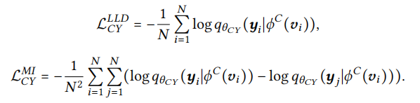

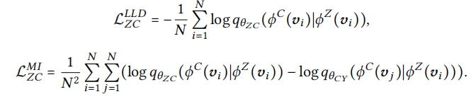
AutoIV
Learning Confounder Representations
Representation Calibration
first stage
second stage
Yuan J, Wu A, Kuang K, et al. Auto iv: Counterfactual prediction via automatic instrumental variable decomposition[J]. ACM Transactions on Knowledge Discovery from Data (TKDD), 2022, 16(4): 1-20.

Slide 14
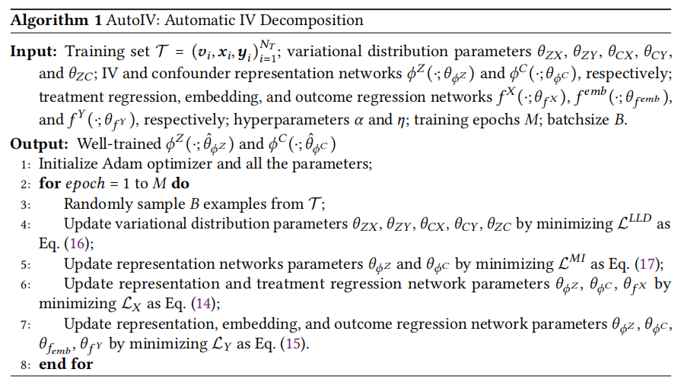

AutoIV
Model Optimization
Yuan J, Wu A, Kuang K, et al. Auto iv: Counterfactual prediction via automatic instrumental variable decomposition[J]. ACM Transactions on Knowledge Discovery from Data (TKDD), 2022, 16(4): 1-20.

Slide 15
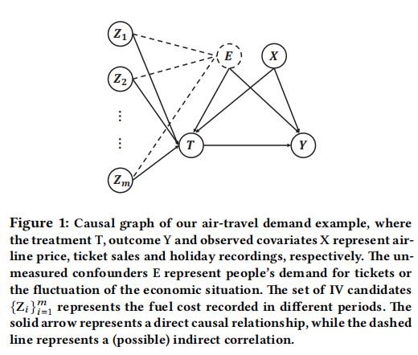
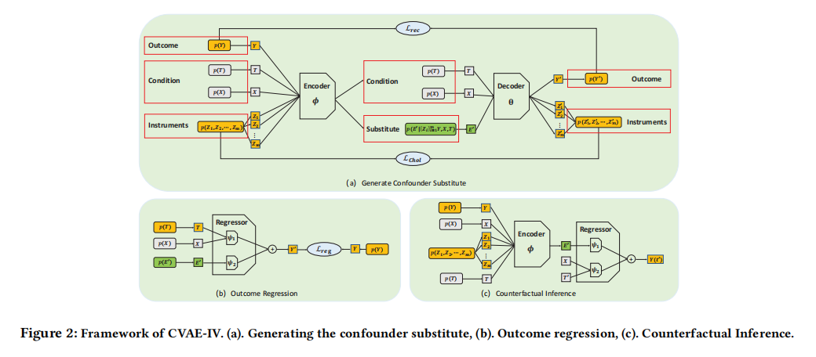
CVAE-IV
Wang H, Yang W, Yang L, et al. Estimating Individualized Causal Effect with Confounded Instruments[C]//Proceedings of the 28th ACM SIGKDD Conference on Knowledge Discovery and Data Mining. 2022: 1857-1867.

